Slide 1
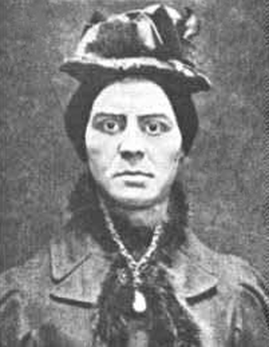
Kate Webster

Slide 2
Background of Kate Webster
had been born as Kate Lawler in Killanne in County Wexford in about 1849
She was imprisoned for larceny in Wexford in December 1864, when she was only about 15 years old
came to England in 1867. In February 1868, she was sentenced to four years of penal servitude (prison) for committing larceny in Liverpool.
After her release in January 1872 she travelled to London and worked as a cleaner and maid, but couldn’t keep out of trouble. She would rent rooms in boarding houses before selling everything of value in the room and absconding.

Slide 3
Continue
She spent 18 months in Wandsworth Prison after being convicted of 36 charges of larceny in May 1875. Shortly after her release she was convicted of the same crime and jailed for a further year in February 1877.
She moved frequently around West London using various aliases, including Webb, Webster, Gibbs, Gibbons, and Lawler.
fell in love with another robber, Mr. Strong. After Kate got pregnant, Mr. Strong left, and she started taking jobs as a house cleaner.
One son actually known of

Slide 4
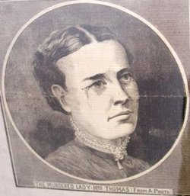
She would steal items from her employers and sell them off, then move on to the next home.
Apart from stealing and lying, Kate had two hobbies: drinking and fighting.
Famously known for the brutal murder of her boss Julia Martha Thomas on March 2, 1879 in her home after Julia came home from church.
pushed her down the stairs, then strangled her, chopped up her body, boiled it and gave the dripping to local children to eat.

Slide 5
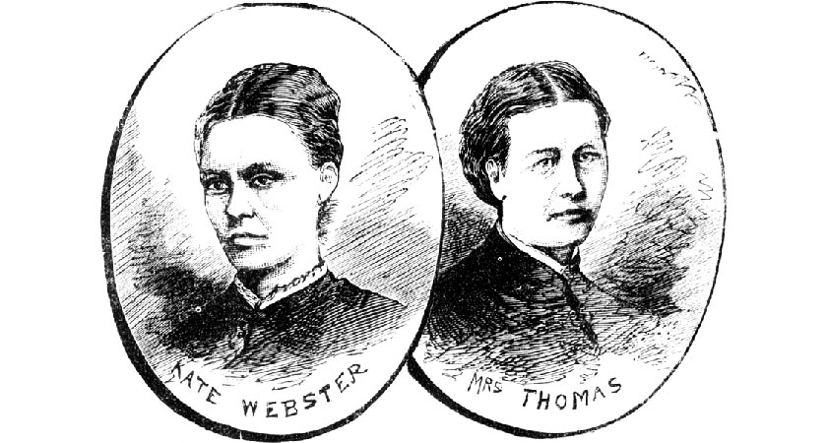
“Richmond Murder or The Barnes Mystery ”

Slide 6
After the murder, Webster posed as Thomas for two weeks, but was exposed and fled back to Ireland and her uncle's home at Killanne near Enniscorthy, County Wexford. She was arrested there on 29 March and was returned to London, where she stood trial at the Old Bailey in July 1879.
Kate Webster went to her appointment with William Marwood on the gallows at Wandsworth Prison on 29th July 1879 and passed into history as one of the most universally despised criminals in history.

Slide 7
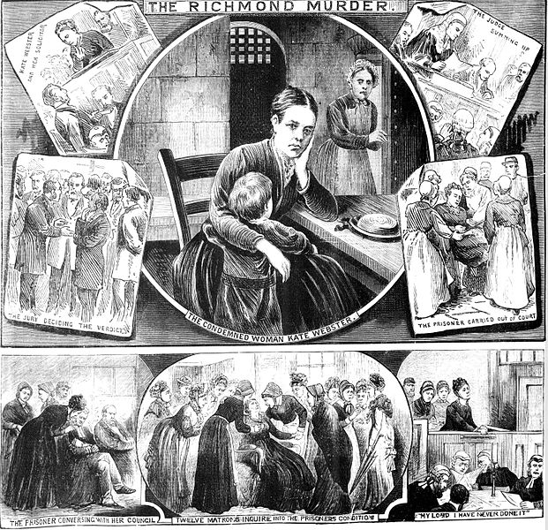

Slide 8
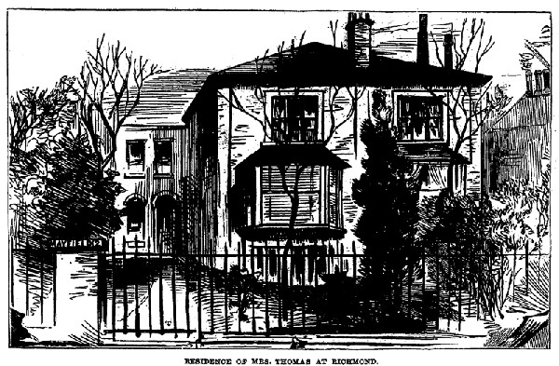
Cottage Of Julia Home and where the murder took place!

Slide 9
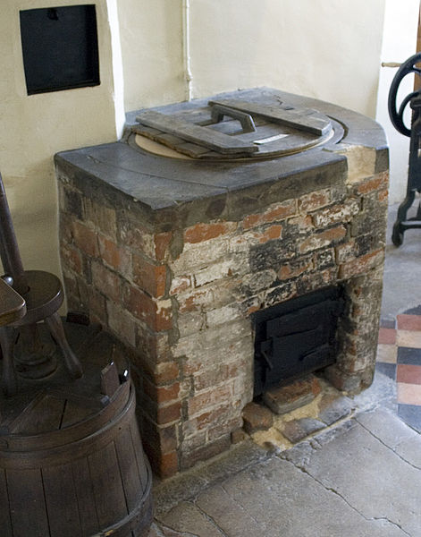
Laundry Boiler
This is boiler Kate used to boil off the fat of Julia body.

Slide 10
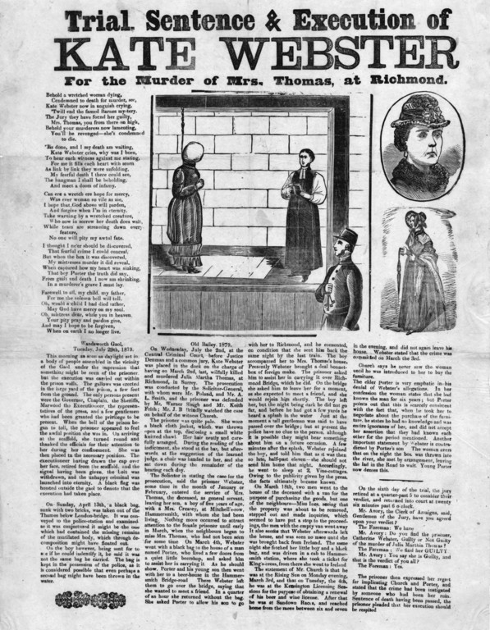
Newspaper Article during the Trial

Slide 11
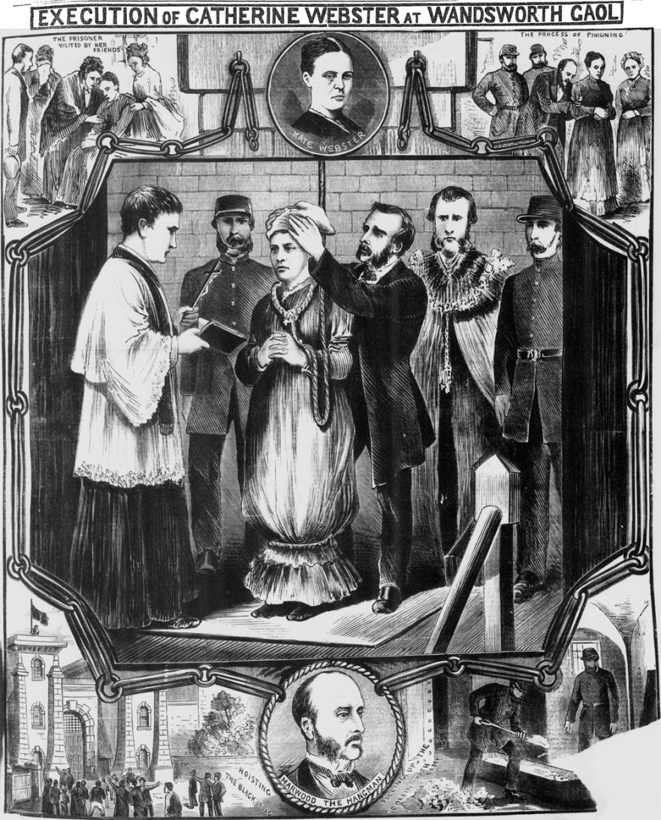
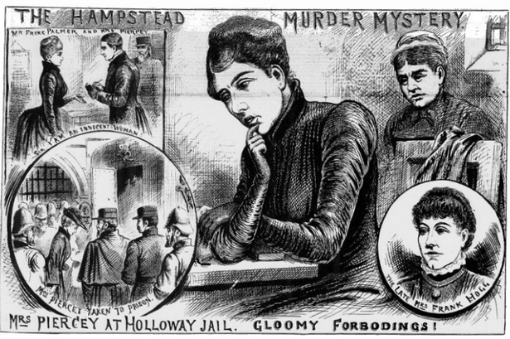

Slide 12
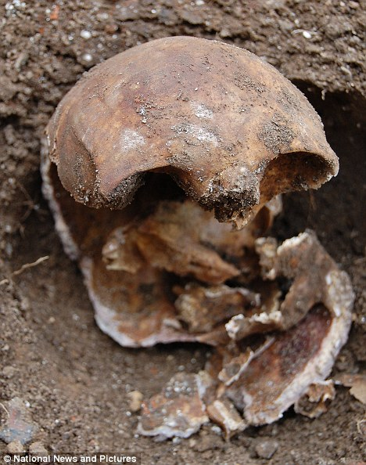
Her skull was found on October 2010 at the home David Attenborough in his garden 131 years after the murder

Slide 13
https://www.irishpost.com/news/ten-facts-kate-webster-irish-maid-hanged-dismembering-employer-victorian-london-131185
https://gizmodo.com/the-killer-maid-who-fed-children-with-fat-boiled-off-he-1720950941
https://murderpedia.org/female.W/w/webster-catherine.htm
https://boredomtherapy.com/kate-webster-murderer/
https://www.findagrave.com/memorial/104299579/julia-martha-thomas

